Slide 1

From various sources on the Internet

Slide 2
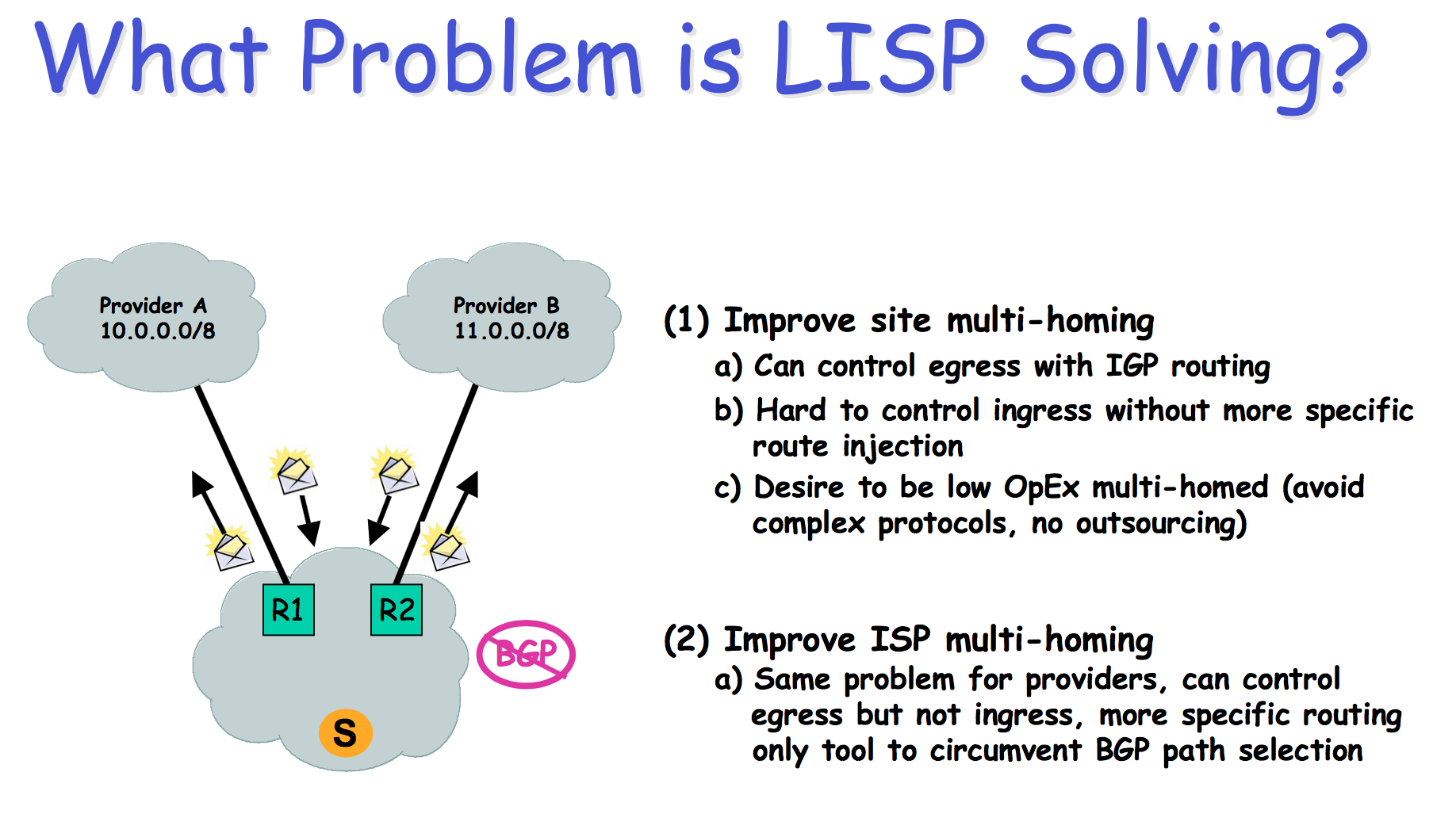

Slide 3
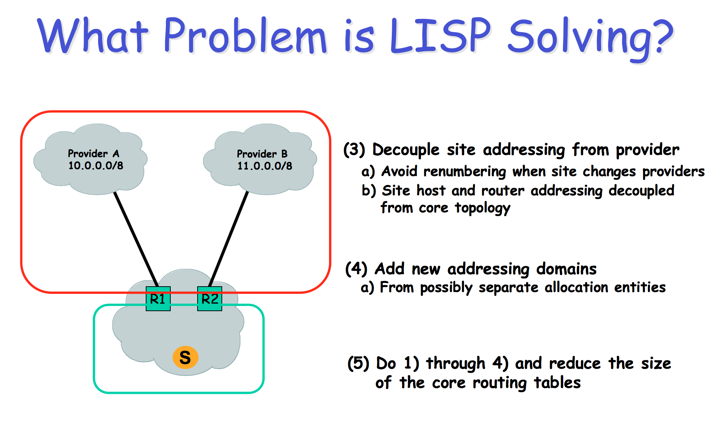

Slide 4
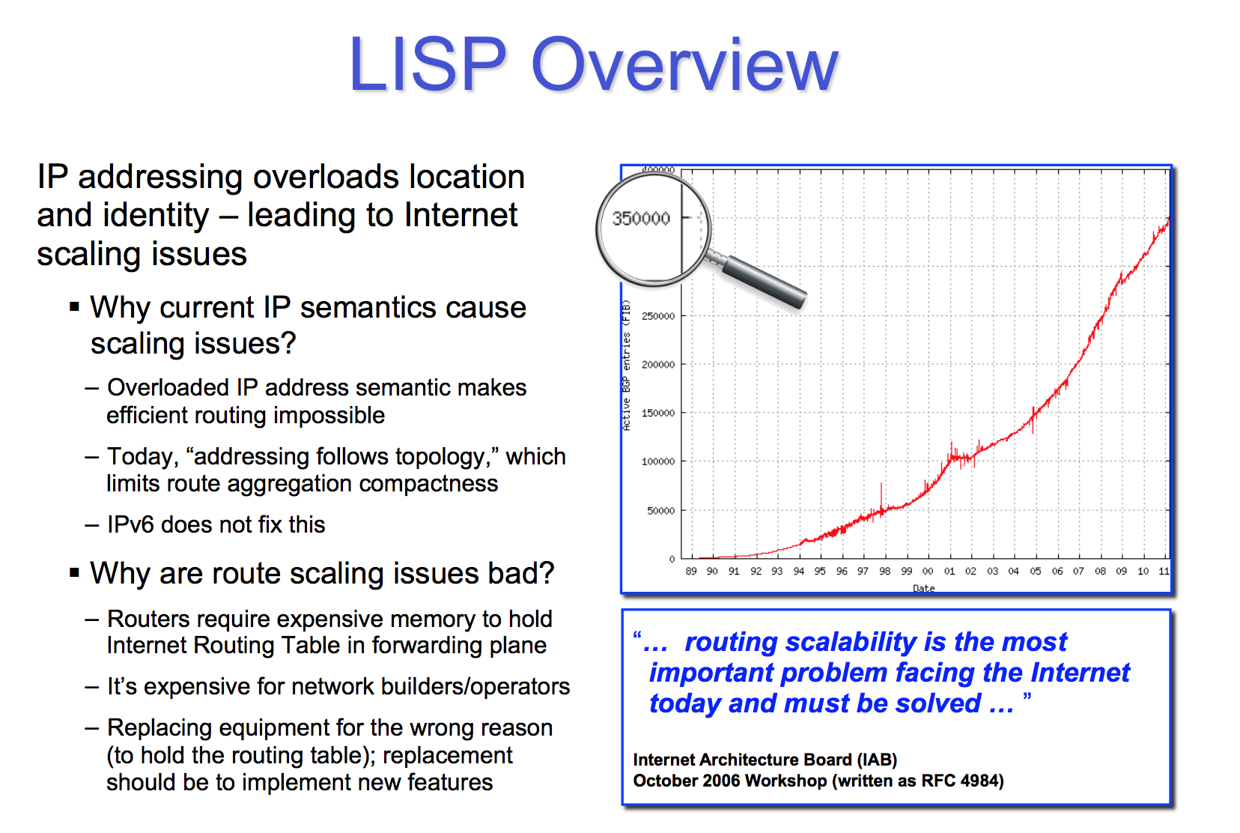

Slide 5
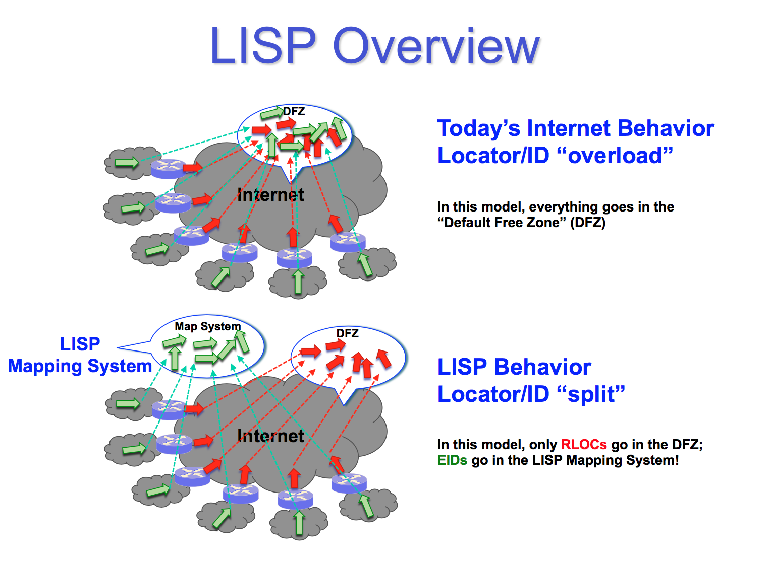

Slide 6
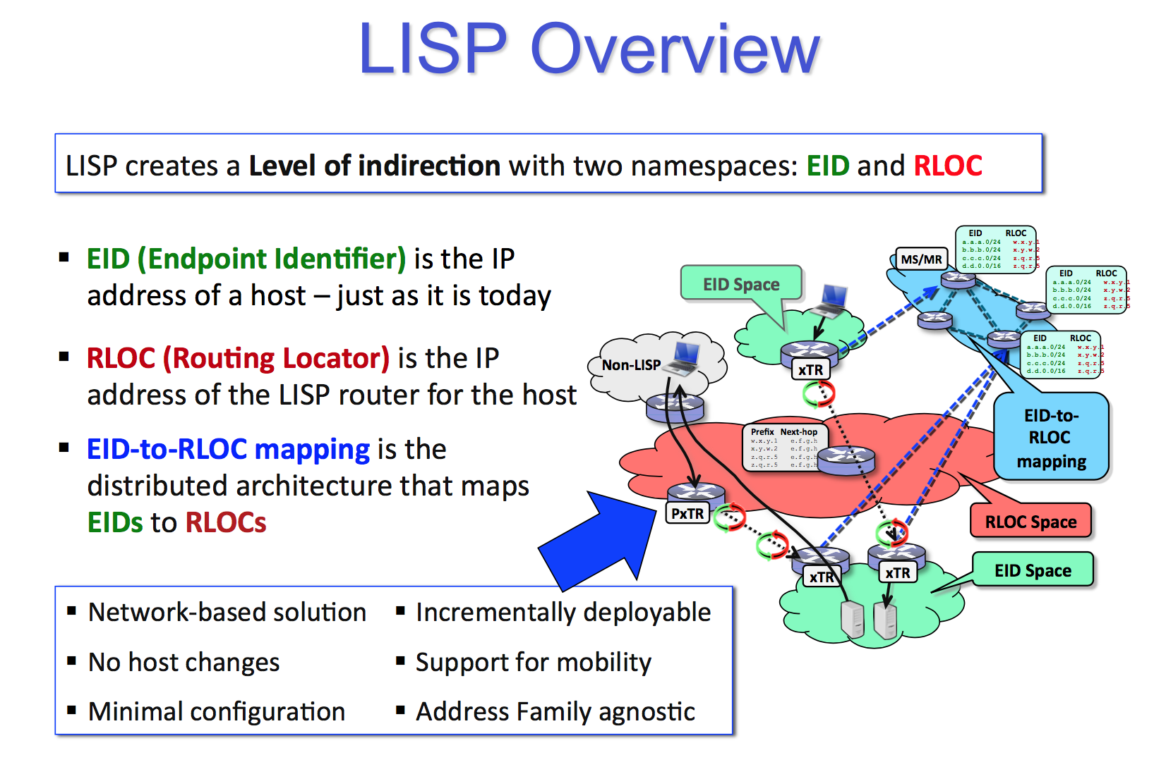

Slide 7
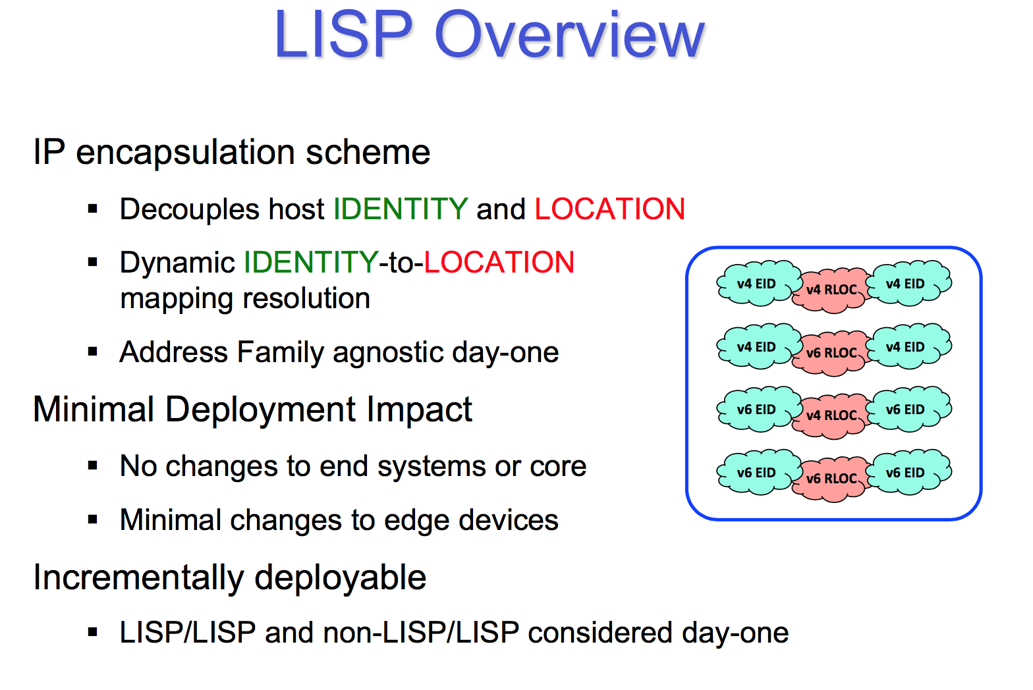

Slide 8
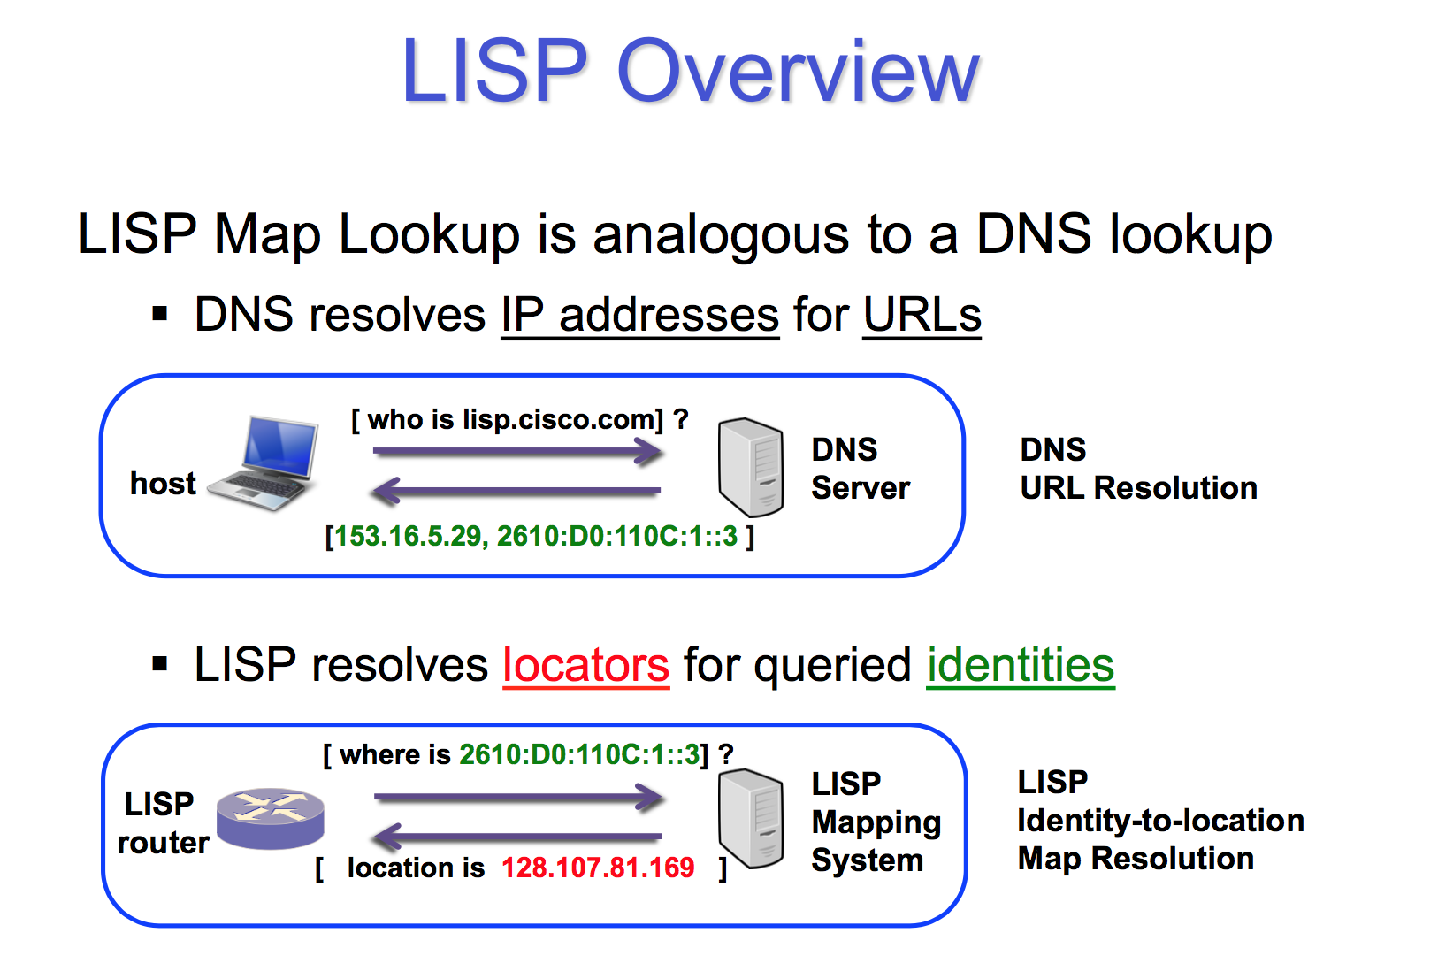

Slide 9
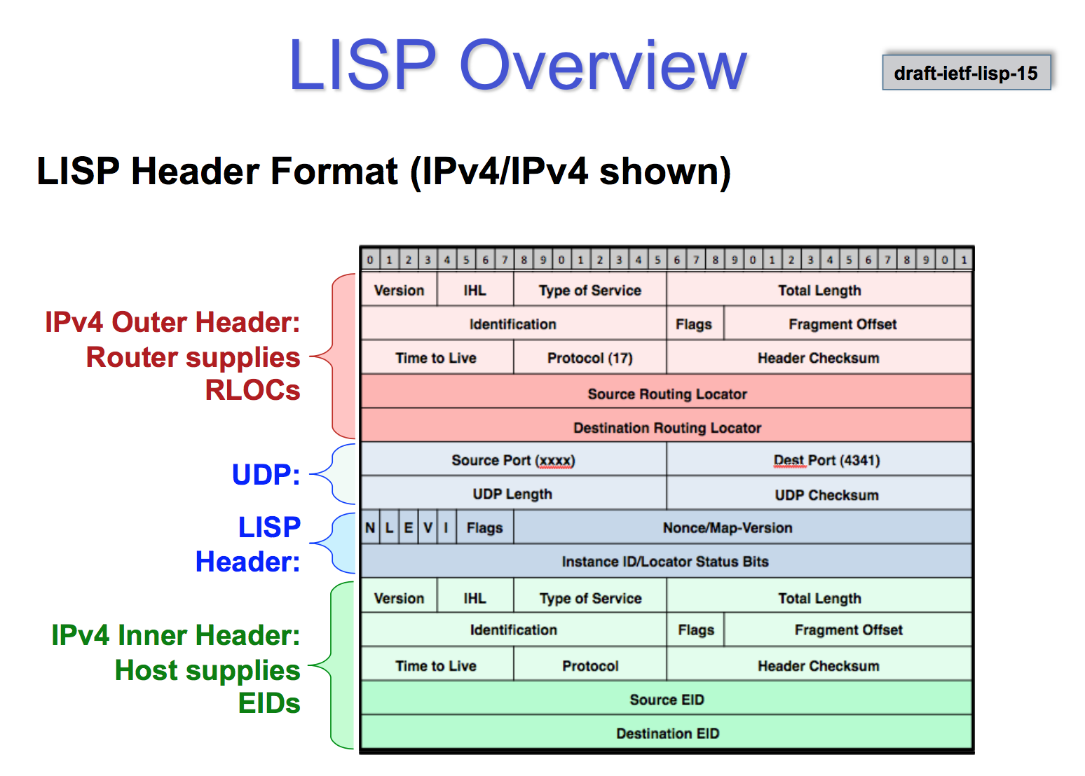

Slide 10
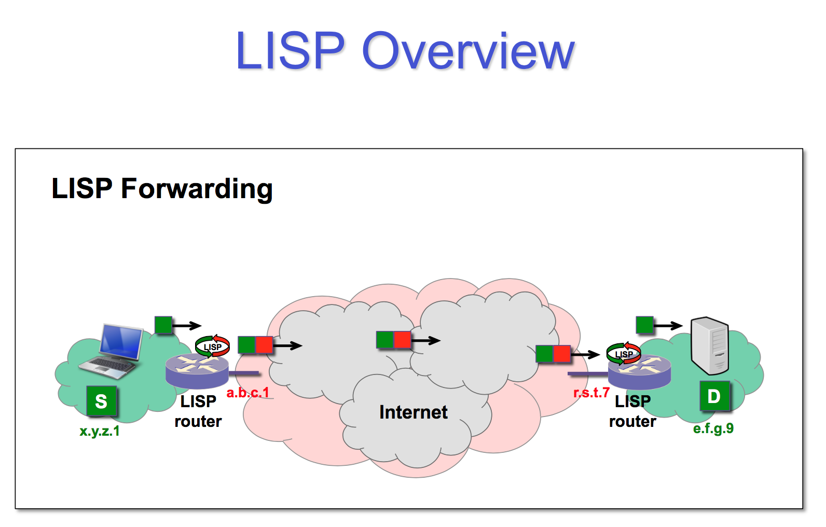

Slide 11
LISP-MN Architecture
DNS
EID_B -> RLOC_1
Map-Server
LISP Mapping
System
Map-Resolver
EID_B?
Registration (RLOC_1)
EID_B
Hostname?
EID_B?
RLOC_1
EID_B, EID_A
RLOC_1
RLOC_1,RLOC_2
EID_B, EID_A
RLOC_2
xTR
PEER
EID_A
PEER
EID_B
Notes:
Mention that the mobile node is a LISP site, and implements xTR functionalities

Slide 12
Handoff
DNS
EID_B -> RLOC_3
EID_B -> RLOC_1
Map-Server
LISP Mapping
System
Map-Resolver
EID_B?
EID_B?
Registration (RLOC_3)
RLOC_3
EID_B, EID_A
RLOC_1
RLOC_2
xTR
PEER
EID_A
PEER
EID_B
RLOC_3
RLOC_3,RLOC_2
EID_B, EID_A

Slide 13









Demo Network
CISCO-SJC-MR-MS-1
MS
MR
PETR
PITR
Site LISP EID Prefix 153.16.10.10/24
LISP EID 153.16.10.25
NTR
IPv4 Internet
Host A
Site RLOC 173.16.254.162
VAF-XTR-1
3G
ATT
LISP Site
WiFi
LISP EID
153.16.21.34
RLOC from 3G 32.152.119.136
RLOC from WiFi 166.205.136.89
LISP EID 153.16.21.34
LISP Mobile-Node
(Android Handset)

